Slide 1
Birds Strike 2000-2011
PROJECT BY TANISH BALSARA

Slide 2
PROBLEM STATEMENT
Transport and communication is one of the crucial domain in field of analytics. Environmental impacts and safety are, nowadays, two major concerns of the scientific community with respect to transport scenarios and to the ever-growing urban areas. These issues gain more importance due to the increasing amount of vehicles and people. Seeking for new solutions is reaching a point where available technologies and artificial intelligence, especially MAS, are being recognized as ways to cope and tackle these kinds of problems in a distributed and more appropriate way.
A bird strike is strictly defined as a collision between a bird and an aircraft which is in flight or on a take-off or landing roll. The term is often expanded to cover other wildlife strikes - with bats or ground animals. Bird Strike is common and can be a significant threat to aircraft safety. For smaller aircraft, significant damage may be caused to the aircraft structure and all aircraft, especially jet-engine ones, are vulnerable to the loss of thrust which can follow the ingestion of birds into engine air intakes. This has resulted in several fatal accidents. Bird strikes may occur during any phase of flight, but are most likely during the take-off, initial climb, approach and landing phases due to the greater numbers of birds in flight at lower levels. To have a closer look the following document visually depicts the data collected on Bird Strikes by FAA between 2000-2011.

Slide 3
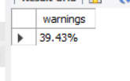
1)How many pilots were warned?
Code-1) select concat(round(count(Pilotwarnedofbirdsorwildlife)/(select count(*) from bird)*100,2),'%') as warnings from bird where Pilotwarnedofbirdsorwildlife='Y’;
Output:-

Slide 4
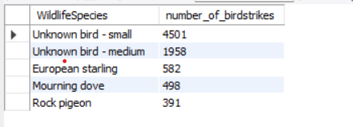
2)Which are top 5 species of bird has caused the most strikes?
Code-select WildlifeSpecies,count(*) as number_of_birdstrikes from birdgroup by WildlifeSpeciesorder by number_of_birdstrikes desc limit 5;
Output:-

Slide 5
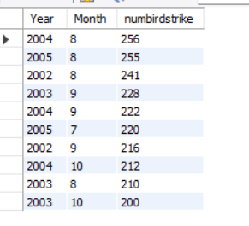
3)What is the distribution of bird strikes by month and year?
Code-select Year,Month,count(*) as numbirdstrike from birdgroup by Year,Month order by numbirdstrike desc limit 10;

Slide 6

4)What is the average cost of damage caused by bird strikes?
Code-select EffectIndicatedDamage,round(sum(CostTotal),2) from birdgroup by EffectIndicatedDamage;
Output:-

Slide 7
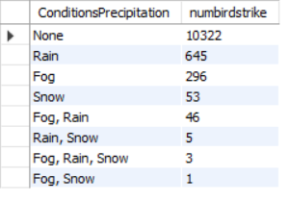
5)Are there any patterns in the time of day or weather conditions when bird strikes are more likely to occur?
Code-select ConditionsPrecipitation,count(*) as numbirdstrike from birdgroup by ConditionsPrecipitation order by numbirdstrike desc;
Output:-
Note:-Rest of the code of this project are uploaded on github.
Link-RevolutionaryAI/SQL_projects (github.com)

Slide 8
THANK YOU

